Slide 1
Chapter 10
Firewalls

Slide 2
Outline
Firewall Design Principles
  Firewall Characteristics
  Types of Firewalls
  Firewall Configurations
Trusted Systems
  Data Access Control
  The Concept of Trusted systems
  Trojan Horse Defense

Slide 3
Firewalls
Effective means of protection a local system or network of systems from network-based security threats while affording access to the outside world via WAN`s or the Internet

Slide 4
Firewall Design
Principles
Information systems undergo a steady evolution (from small LAN`s to Internet connectivity)
Strong security features for all workstations and servers not established

Slide 5
Firewall Design
Principles
The firewall is inserted between the premises network and the Internet
Aims:
  Establish a controlled link
  Protect the premises network from Internet-based attacks
  Provide a single choke point

Slide 6
Firewall Characteristics
Design goals:
  All traffic from inside to outside must pass through the firewall (physically blocking all access to the local network except via the firewall)
  Only authorized traffic (defined by the local security police) will be allowed to pass

Slide 7
Firewall Characteristics
Design goals:
  The firewall itself is immune to penetration (use of trusted system with a secure operating system)

Slide 8
Firewall Characteristics
Four general techniques:
Service control
  Determines the types of Internet services that can be accessed, inbound or outbound
Direction control
  Determines the direction in which particular service requests are allowed to flow

Slide 9
Firewall Characteristics
User control
  Controls access to a service according to which user is attempting to access it
Behavior control
  Controls how particular services are used (e.g. filter e-mail)

Slide 10
Types of Firewalls
Three common types of Firewalls:
  Packet-filtering routers
  Application-level gateways
  Circuit-level gateways
  (Bastion host)

Slide 11
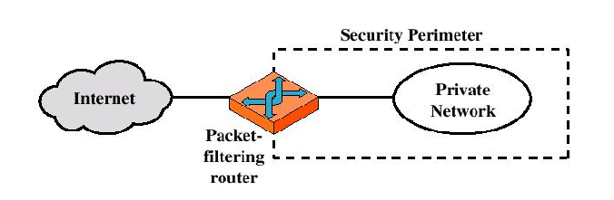
Types of Firewalls
Packet-filtering Router

Slide 12
Types of Firewalls
Packet-filtering Router
  Applies a set of rules to each incoming IP packet and then forwards or discards the packet
  Filter packets going in both directions
  The packet filter is typically set up as a list of rules based on matches to fields in the IP or TCP header
  Two default policies (discard or forward)

Slide 13
Types of Firewalls
Advantages:
  Simplicity
  Transparency to users
  High speed
Disadvantages:
  Difficulty of setting up packet filter rules
  Lack of Authentication

Slide 14
Types of Firewalls
Possible attacks and appropriate countermeasures
  IP address spoofing
  Source routing attacks
  Tiny fragment attacks

Slide 15
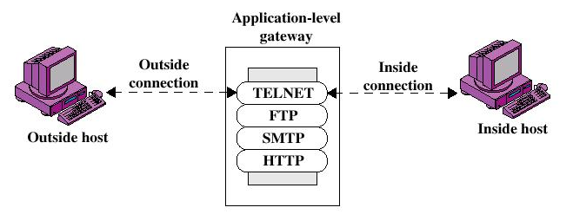
Types of Firewalls
Application-level Gateway

Slide 16
Types of Firewalls
Application-level Gateway
  Also called proxy server
  Acts as a relay of application-level traffic

Slide 17
Types of Firewalls
Advantages:
  Higher security than packet filters
  Only need to scrutinize a few allowable applications
  Easy to log and audit all incoming traffic
Disadvantages:
  Additional processing overhead on each connection (gateway as splice point)

Slide 18
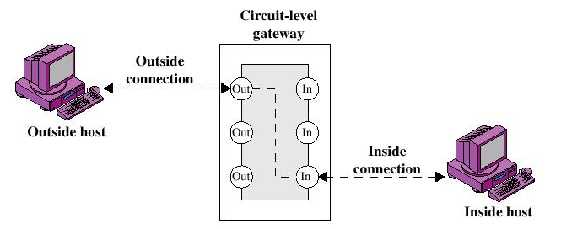
Types of Firewalls
Circuit-level Gateway

Slide 19
Types of Firewalls
Circuit-level Gateway
  Stand-alone system or
  Specialized function performed by an Application-level Gateway
  Sets up two TCP connections
  The gateway typically relays TCP segments from one connection to the other without examining the contents

Slide 20
Types of Firewalls
Circuit-level Gateway
  The security function consists of determining which connections will be allowed
  Typically use is a situation in which the system administrator trusts the internal users
  An example is the SOCKS package

Slide 21
Types of Firewalls
Bastion Host
  A system identified by the firewall administrator as a critical strong point in the network´s security
  The bastion host serves as a platform for an application-level or circuit-level gateway

Slide 22
Firewall Configurations
In addition to the use of simple configuration of a single system (single packet filtering router or single gateway), more complex configurations are possible
Three common configurations

Slide 23
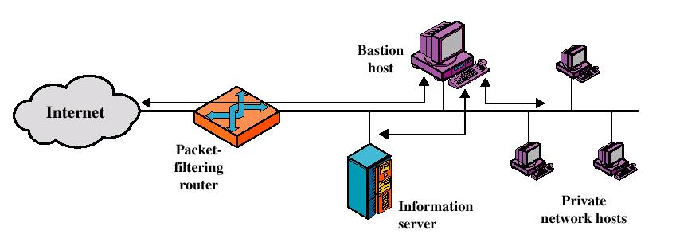
Firewall Configurations
Screened host firewall system (single-homed bastion host)

Slide 24
Firewall Configurations
Screened host firewall, single-homed bastion configuration
Firewall consists of two systems:
  A packet-filtering router
  A bastion host

Slide 25
Firewall Configurations
Configuration for the packet-filtering router:
  Only packets from and to the bastion host are allowed to pass through the router
The bastion host performs authentication and proxy functions

Slide 26
Firewall Configurations
Greater security than single configurations because of two reasons:
  This configuration implements both packet-level and application-level filtering (allowing for flexibility in defining security policy)
  An intruder must generally penetrate two separate systems

Slide 27
Firewall Configurations
This configuration also affords flexibility in providing direct Internet access (public information server, e.g. Web server)

Slide 28
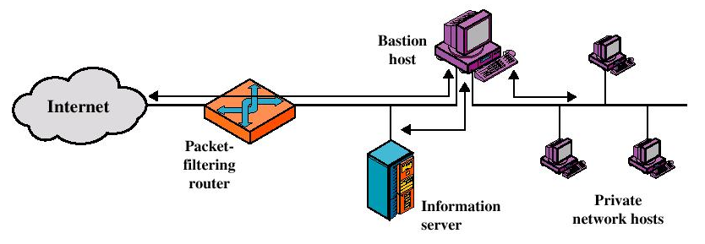
Firewall Configurations
Screened host firewall system (dual-homed bastion host)

Slide 29
Firewall Configurations
Screened host firewall, dual-homed bastion configuration
  The packet-filtering router is not completely compromised
  Traffic between the Internet and other hosts on the private network has to flow through the bastion host

Slide 30
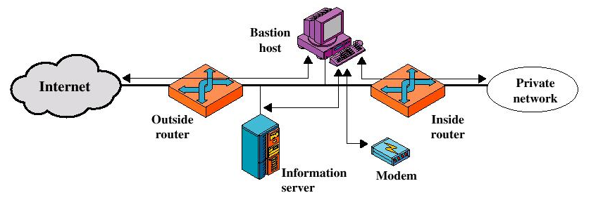
Firewall Configurations
Screened-subnet firewall system

Slide 31
Firewall Configurations
Screened subnet firewall configuration
  Most secure configuration of the three
  Two packet-filtering routers are used
  Creation of an isolated sub-network

Slide 32
Firewall Configurations
Advantages:
  Three levels of defense to thwart intruders
  The outside router advertises only the existence of the screened subnet to the Internet (internal network is invisible to the Internet)

Slide 33
Firewall Configurations
Advantages:
  The inside router advertises only the existence of the screened subnet to the internal network (the systems on the inside network cannot construct direct routes to the Internet)

Slide 34
Trusted Systems
One way to enhance the ability of a system to defend against intruders and malicious programs is to implement trusted system technology

Slide 35
Data Access Control
Through the user access control procedure (log on), a user can be identified to the system
Associated with each user, there can be a profile that specifies permissible operations and file accesses
The operation system can enforce rules based on the user profile

Slide 36
Data Access Control
General models of access control:
  Access matrix
  Access control list
  Capability list

Slide 37
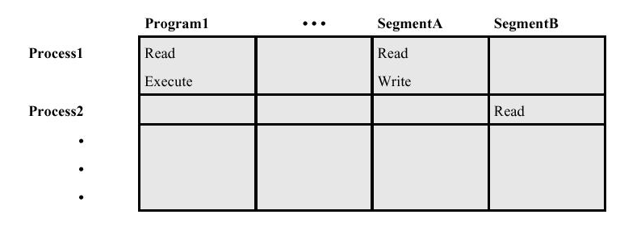
Data Access Control
Access Matrix

Slide 38
Data Access Control
Access Matrix: Basic elements of the model
  Subject: An entity capable of accessing objects, the concept of subject equates with that of process
  Object: Anything to which access is controlled (e.g. files, programs)
  Access right: The way in which an object is accessed by a subject (e.g. read, write, execute)

Slide 39
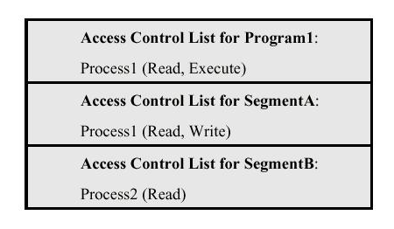
Data Access Control
Access Control List: Decomposition of the matrix by columns

Slide 40
Data Access Control
Access Control List
  An access control list lists users and their permitted access right
  The list may contain a default or public entry

Slide 41
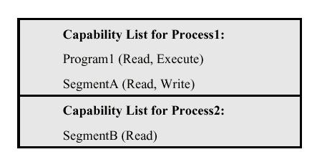
Data Access Control
Capability list: Decomposition of the matrix by rows

Slide 42
Data Access Control
Capability list
  A capability ticket specifies authorized objects and operations for a user
  Each user have a number of tickets

Slide 43
The Concept of
Trusted Systems
Trusted Systems
  Protection of data and resources on the basis of levels of security (e.g. military)
  Users can be granted clearances to access certain categories of data

Slide 44
The Concept of
Trusted Systems
Multilevel security
  Definition of multiple categories or levels of data
A multilevel secure system must enforce:
  No read up: A subject can only read an object of less or equal security level (Simple Security Property)
  No write down: A subject can only write into an object of greater or equal security level (*-Property)

Slide 45
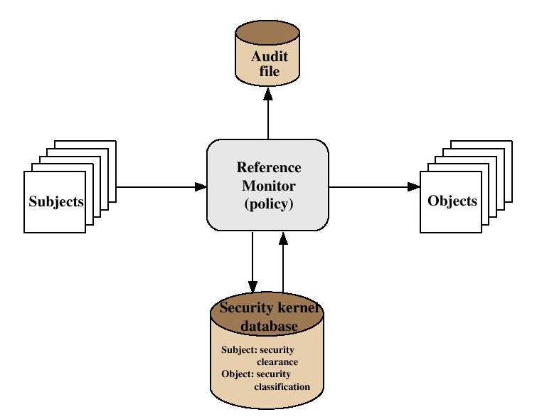
The Concept of
Trusted Systems
Reference Monitor Concept: Multilevel security for a data processing system

Slide 46
The Concept of
Trusted Systems

Slide 47
The Concept of
Trusted Systems
Reference Monitor
  Controlling element in the hardware and operating system of a computer that regulates the access of subjects to objects on basis of security parameters
  The monitor has access to a file (security kernel database)
  The monitor enforces the security rules (no read up, no write down)

Slide 48
The Concept of
Trusted Systems
Properties of the Reference Monitor
  Complete mediation: Security rules are enforced on every access
  Isolation: The reference monitor and database are protected from unauthorized modification
  Verifiability: The reference monitor’s correctness must be provable (mathematically)

Slide 49
The Concept of
Trusted Systems
A system that can provide such verifications (properties) is referred to as a trusted system

Slide 50
Trojan Horse Defense
Secure, trusted operating systems are one way to secure against Trojan Horse attacks

Slide 51
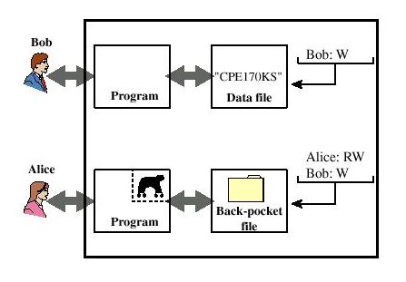
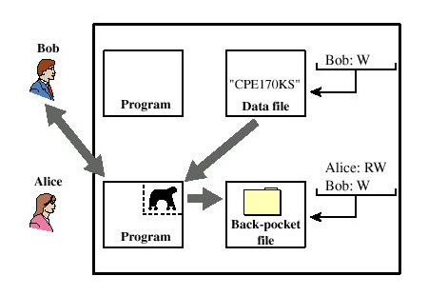
Trojan Horse Defense

Slide 52
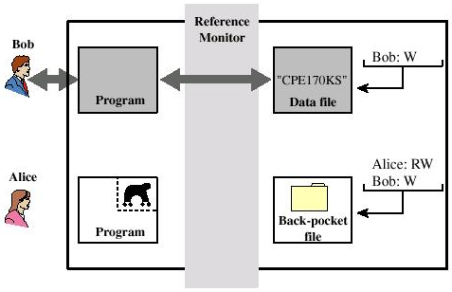
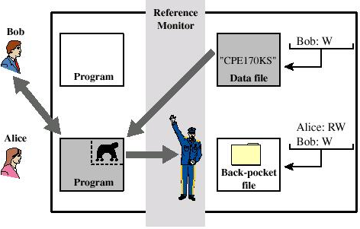
Trojan Horse Defense

Slide 53
Recommended Reading
Chapman, D., and Zwicky, E. Building Internet Firewalls. O’Reilly, 1995
Cheswick, W., and Bellovin, S. Firewalls and Internet Security: Repelling the Wily Hacker. Addison-Wesley, 2000
Gasser, M. Building a Secure Computer System. Reinhold, 1988
Pfleeger, C. Security in Computing. Prentice Hall, 1997

